Slide 1

CyberQuiz: An Interactive Web Platform for Cybersecurity Awareness
Presented By:
ABOUHANE Zahra, BAZGOUR Yassine
Evaluated By:
Mariya Ouaissa
https://www.flaticon.com/search?word=data

Slide 2
Problematic
01

Slide 3
1.3 billion individuals
were victims of hacking-related incidents
(2024)
https://www.varonis.com/blog/data-breach-statistics

Slide 4
Aim
02

Slide 5

Gamification System For Cyber Security Awareness

Slide 6
Proposed Solution
03

Slide 7

Intelligent Cyber Security Quiz

Slide 8
System Architecture
04

Slide 9






Wrong Answer
Heart Loss
Deliver Punishment / Death After 3 Losses
Provide
Response
Evaluate
Response
Provide
Question
Deliver Reward / Win after 20 Questions
User
Interface
Correct Answer
Achieve Progress

Slide 10
Interface
06

Slide 11



Technologies Used
HTML
Javascript
CSS

Slide 12
Results
07

Slide 13
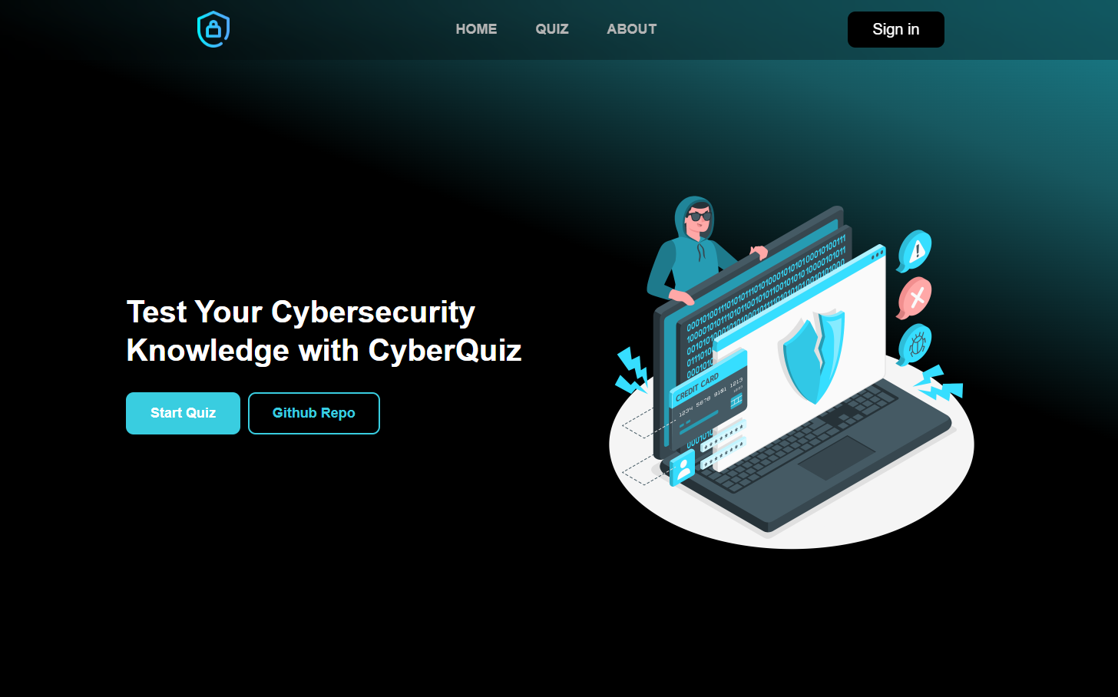

Slide 14
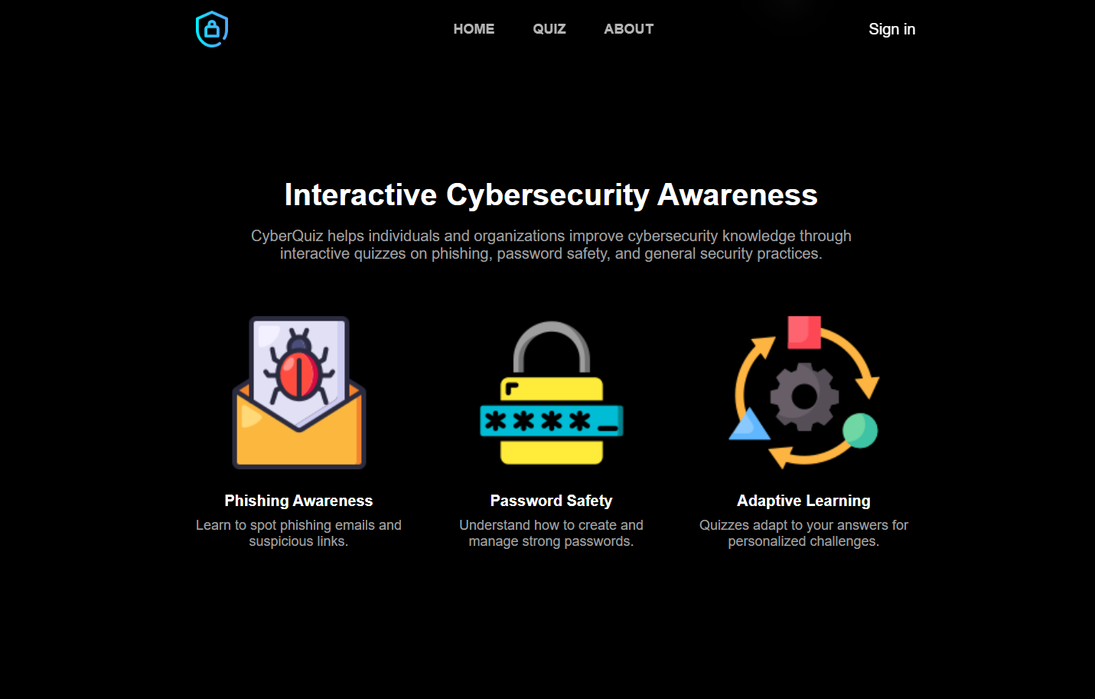

Slide 15
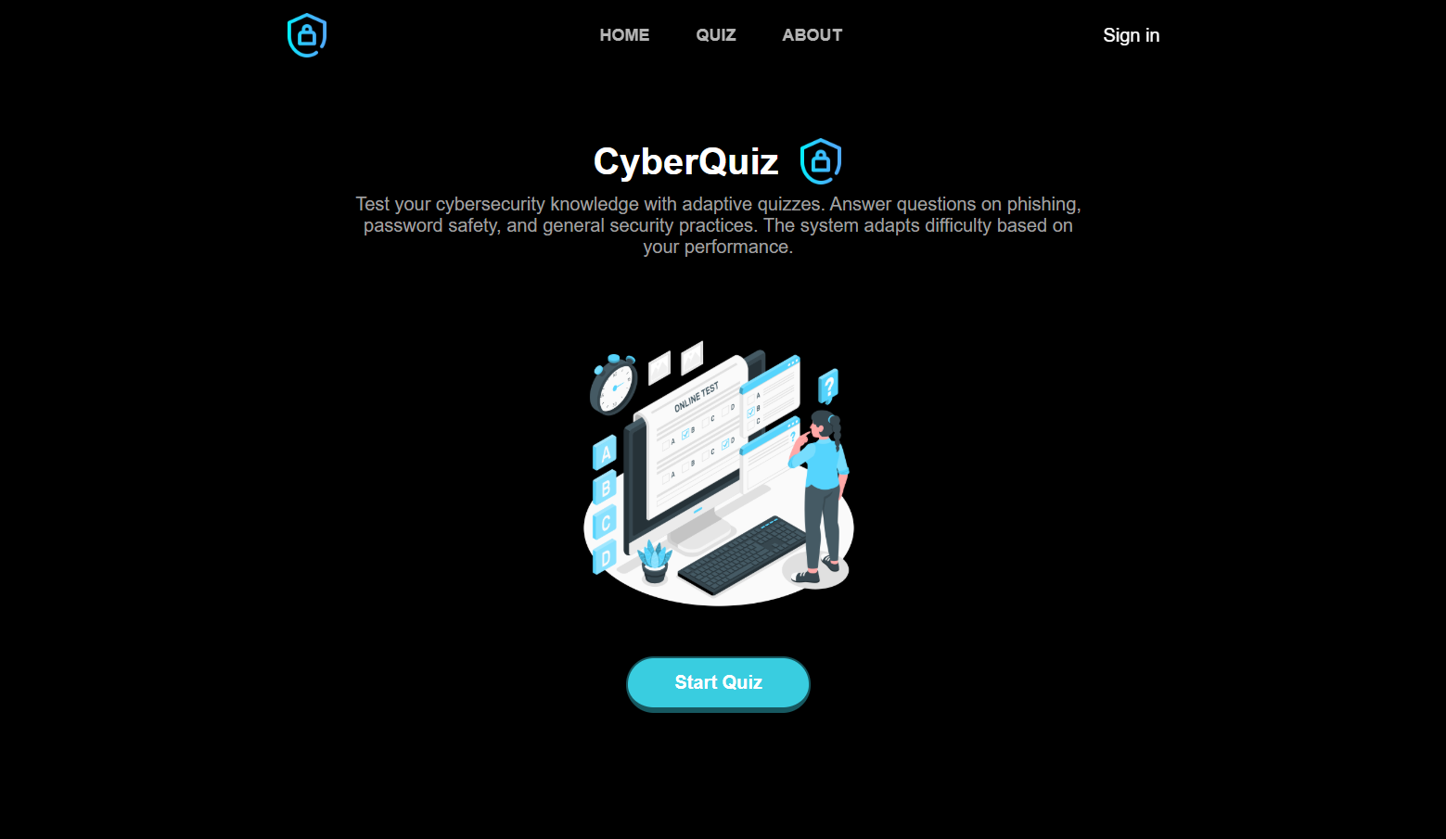

Slide 16
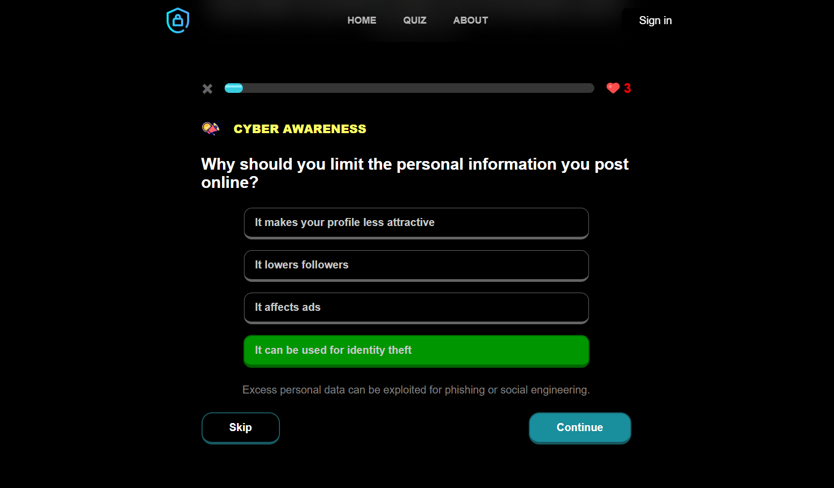

Slide 17
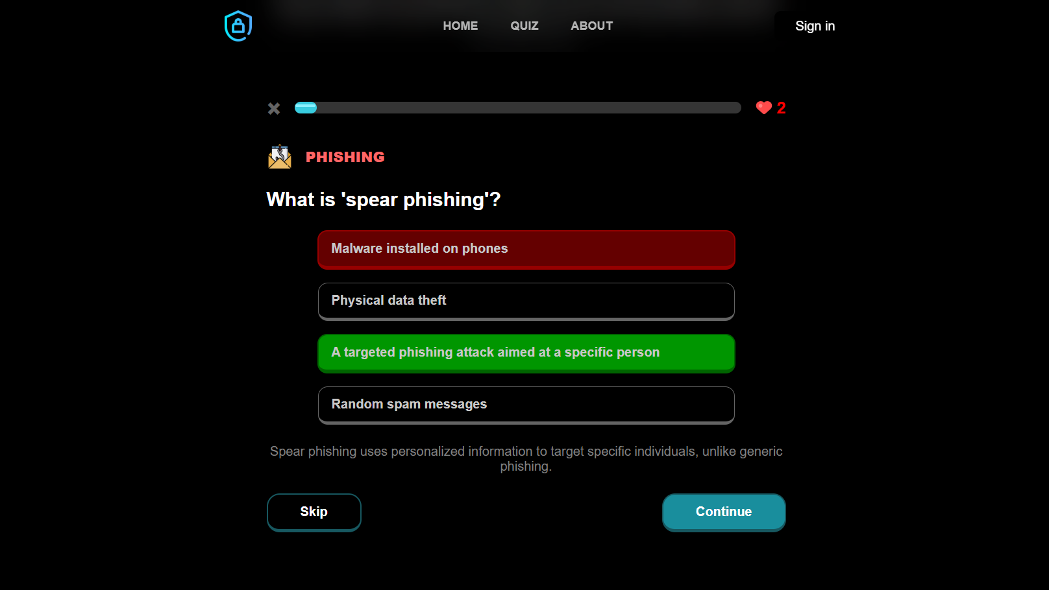

Slide 18
Discussion
09

Slide 19



Benefits
Education Goal
Corporate
Training
Personal Learning
Integrate into schools or universities to teach cybersecurity basics.
Train employees on safe online practices and security awareness.
Improve your cybersecurity skills at your own pace.

Slide 20


Limitations
Limited
NOQ
Not Directed to Professionals

Slide 21


Future Work
Enlarge The Questions Dataset
Improve The Punishments And Rewards System

Slide 22

Thank You

